Slide 1
Project 258: Image Captioning
Team Ninjas
Shreya Goyal
Rishitha Bandi
Bhuvana

Slide 2
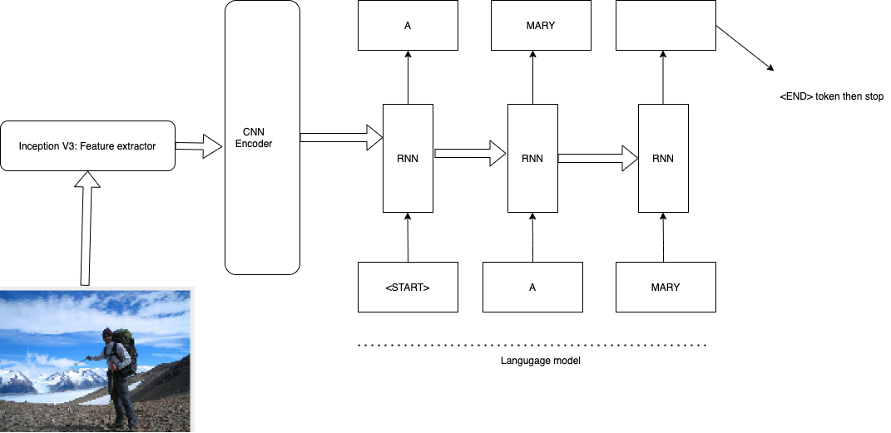
Architecture

Slide 3
Dataset
MSCOCO Dataset
The dataset contains over 82,000 images, each of which has at least 5 different caption annotations

Slide 4
Implementation
Used Teacher forcing technique which is method for quickly and efficiently training recurrent neural network models that use the ground truth from a prior time step as input.
Attention based RNN to improve the performance of encoder decoder model for long captions.
Used checkpoints to save best model.
Created Flask application using saved checkpoint.

Slide 5
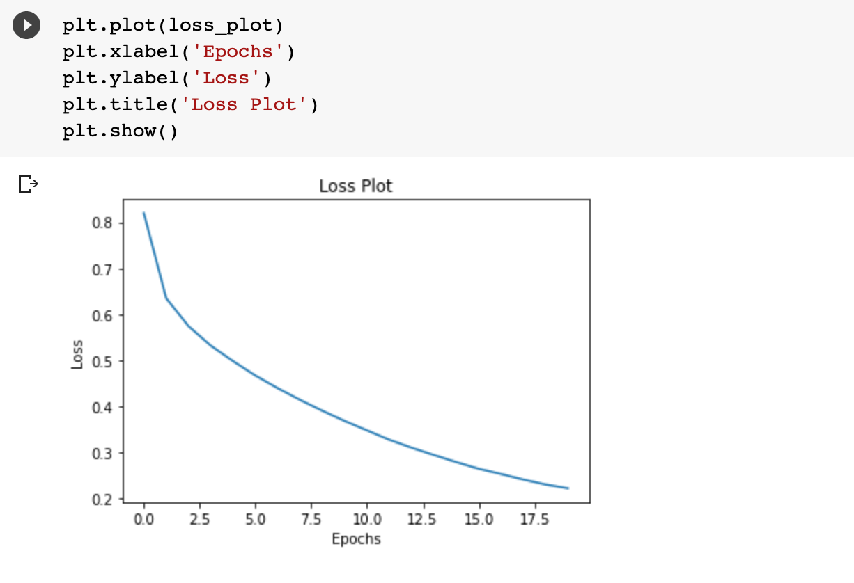
Training

Slide 6
TF2 colab:
TFX colab:
https://colab.research.google.com/drive/1tA15NyR_7R3Q3Wnd3-QAyuHa4vSnTka8?usp=sharing
https://colab.research.google.com/drive/1999BDrsJNIbV-kEq9iNC4ToEm86eZK3D?usp=sharing

Slide 7
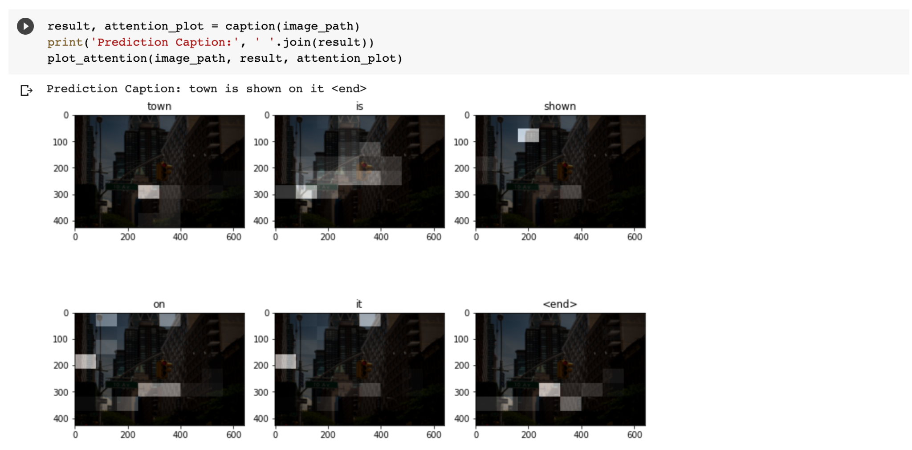
Prediction:

Slide 8
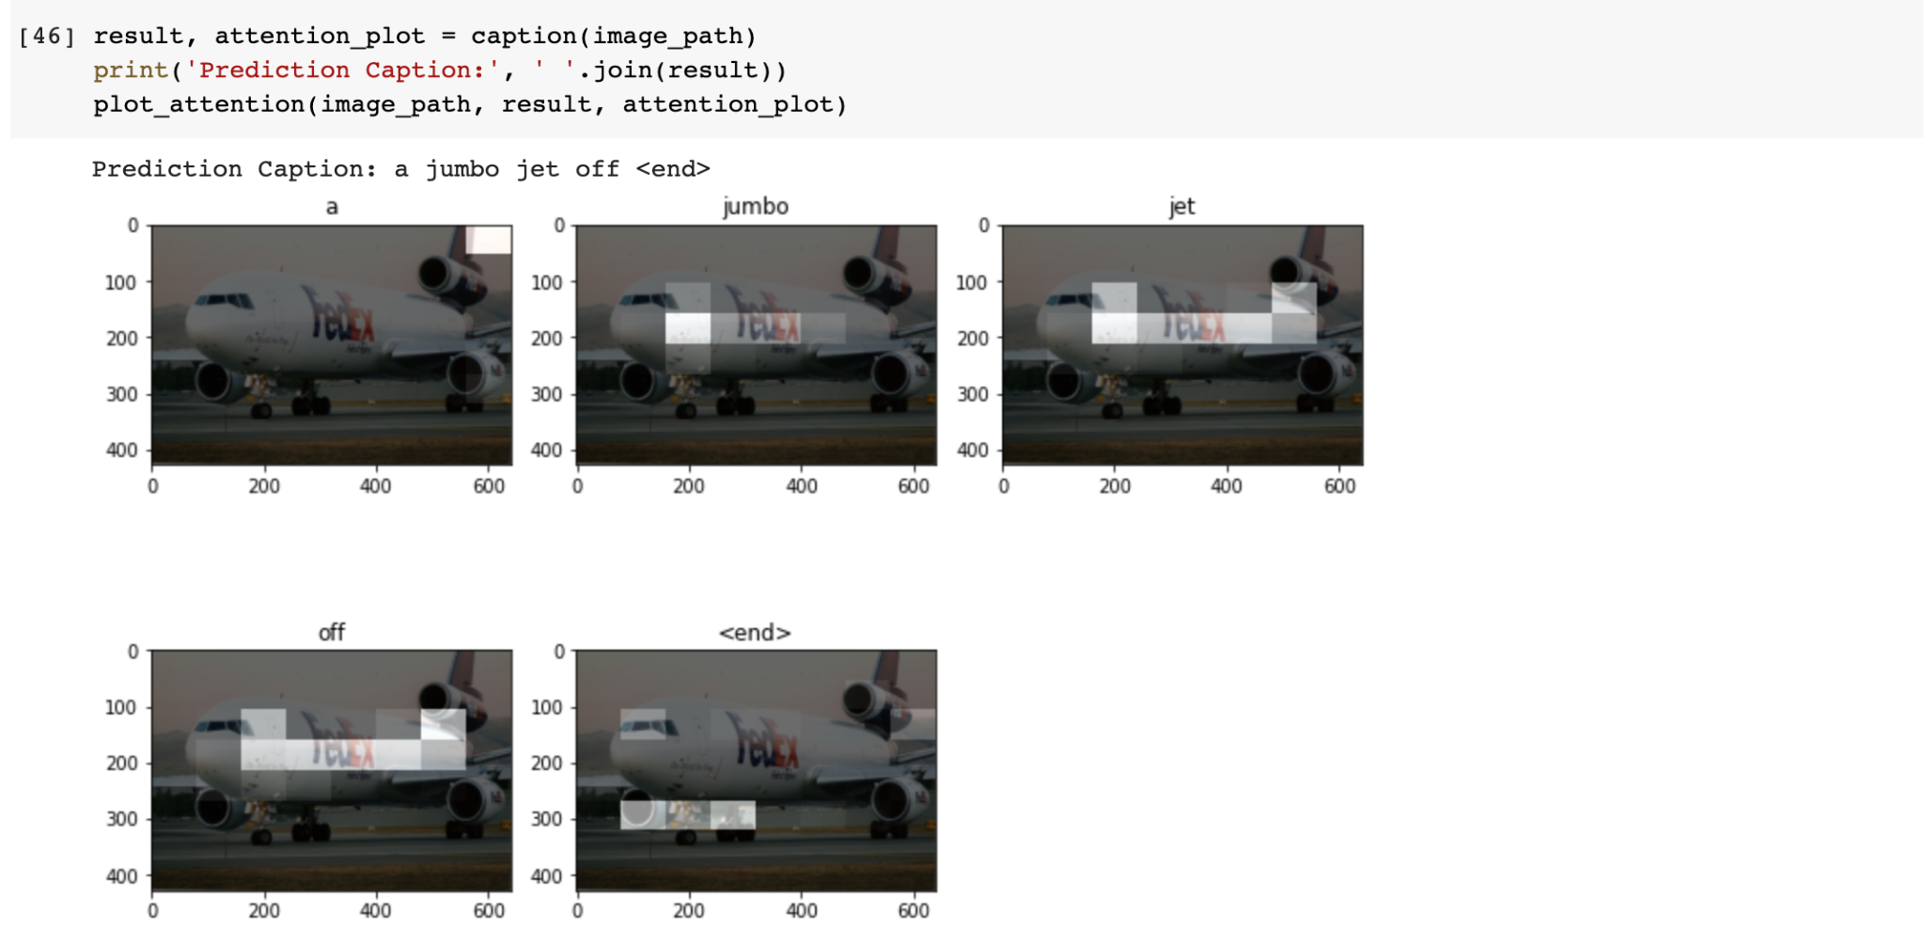
Prediction:

Slide 9
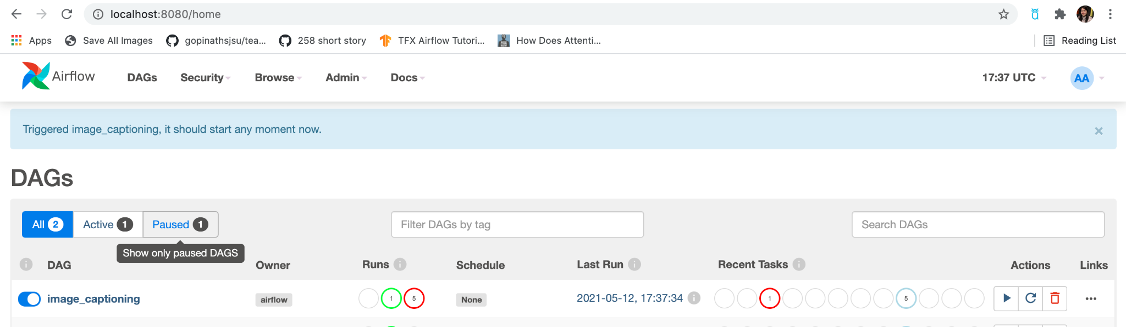
TFX Airflow

Slide 10
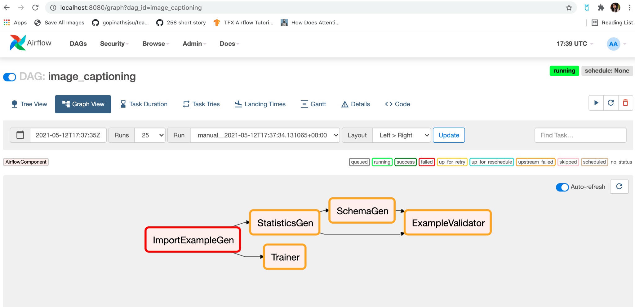
TFX Airflow

Slide 11
Web Application

